Slide 1

OSHA Turns Up the Heat
Courtney M. Malveaux, Esq.
(804) 212-2862
Courtney.Malveaux@jacksonlewis.com
Jackson Lewis P.C.
Notes:
BD personnel to intro?

Slide 2
Agenda
OSHA Enforcement - Then and Now
The Heat Illness Standard
Best Practices for Heat Illness Inspections
Notes:
Courtney

Slide 3
OSHA Enforcement – Then and Now
Notes:
Ray

Slide 4

Heat Illness: What is it?
The body normally cools itself by sweating
During hot weather, especially with high humidity, sweating isn't enough
Heat illnesses range from heat rash and heat cramps to heat exhaustion and heat stroke
Heat stroke requires immediate medical attention and can result in death.
Notes:
Ray

Slide 5
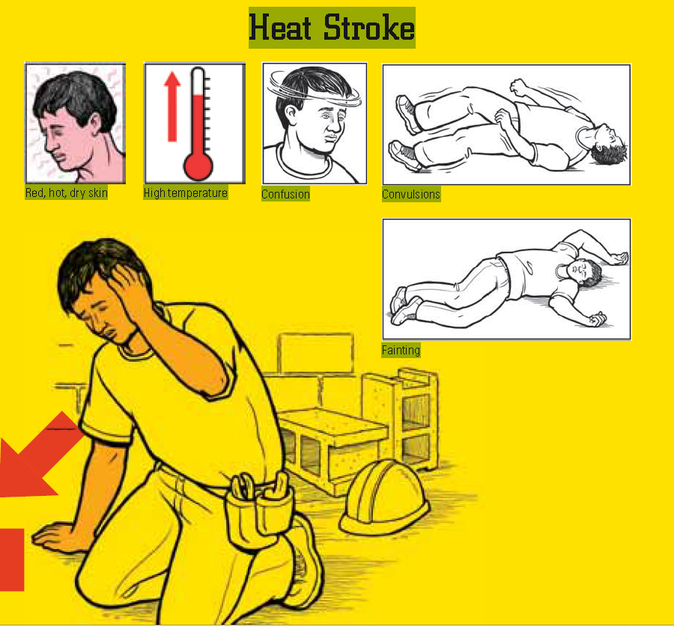
Signs & Symptoms
Heat Stroke
  Body's temperature regulation fails =- body temperature rises to critical levels
  Heat stroke is a medical emergency that may result in death
  Primary signs and symptoms of heat stroke:
    Confusion
    Irrational behavior
    Loss of consciousness
    Convulsions
    A lack of sweating (usually)
    Hot, dry skin; and an abnormally high body temperature
Notes:
Ray

Slide 6
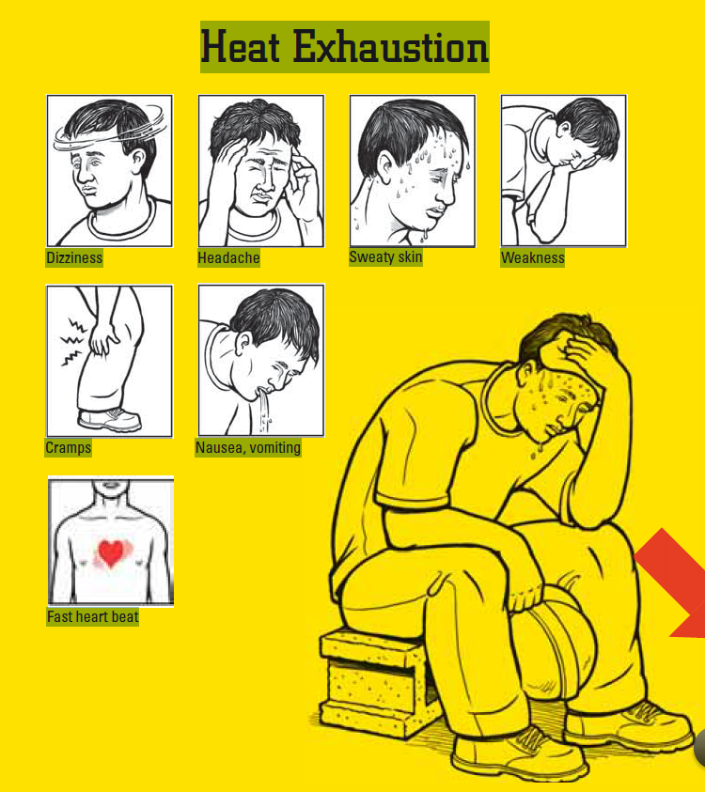
Signs & Symptoms
Heat Exhaustion
  Headache, nausea, vertigo, weakness, thirst, and giddiness
  Fainting or heat collapse is often associated with heat exhaustion
  Similar symptoms of heat stroke
Notes:
Ray

Slide 7

Signs & Symptoms
Heat Cramps
  Usually due to an electrolyte imbalance caused by sweating
Heat Rashes
  Most common problem in hot work environments where the skin is persistently wetted by unevaporated sweat
Heat Fatigue
  Impaired performance of skilled manual, mental, or vigilance jobs
  There is no treatment for heat fatigue except to remove the heat stress before a more serious heat-related condition develops
Notes:
Ray
Often caused by a lack of acclimatization. A program of acclimatization and training for work in hot environments is advisable

Slide 8
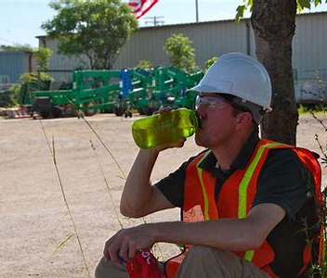
Traditional OSHA Guidance
Water – Rest – Shade
Acclimatization and Breaks
Notes:
Ray

Slide 9
How does OSHA enforce heat illness?
The General Duty Clause
General Duty Clause -- § 5(a)(1) of the OSH Act -- Employers are required to provide a safe and healthful work environment.
Employers may be found in violation of the general duty clause if they fail to reduce or eliminate recognized heat hazards that cause or are likely to cause death or serious physical harm to employees when there is a feasible method to abate the hazard.
Notes:
Melanie

Slide 10

How has the General Duty Clause been enforced?
A Case Study – U.S. Postal Service
Mail carrier returned from a five week absence for knee surgery
The area was under a heat advisory from the National Weather Service.
Called supervisor several times over the period of two days complaining of not feeling well, “hot, real hot”
Collapsed due to hyperthermia
OSHA cited Willful violation of 5(a)(1) with a $70,000 penalty
Citation was upheld
Notes:
Melanie

Slide 11

How has the General Duty Clause been enforced?
Another Case Study – A.H. Sturgill Roofing, Inc.
60-year-old temporary worker with various pre-existing medical conditions working on roof – first day on job
Died three weeks later from complications from heat stroke
Review Commission held that ALJ erred in relying on National Weather Service chart – vacated citations
Defining hazard as “Excessive Heat” was not sufficient to establish general duty clause violation
Employer did implement some of the abatement measures
Notes:
Melanie

Slide 12
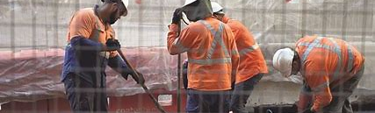
OSHA’s National Emphasis Program
OSHA’s focus on the “vulnerable worker”
Three year duration
Top priority
Notes:
Courtney

Slide 13
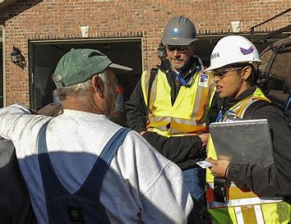
Increased Inspections by Priority
Complaints and hospitalizations
Programmed inspections by NAICS Code
Follow up inspections
Notes:
Melanie

Slide 14
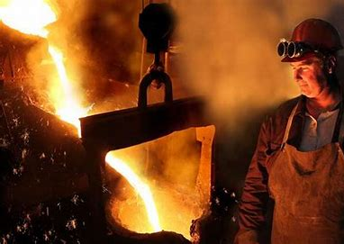
Common Workplaces with Heat Illness Exposures
Indoor
  Foundries, brick-firing and ceramic plants, glass products facilities, rubber products factories, electrical utilities (particularly boiler rooms), bakeries, confectioneries, commercial kitchens, laundries, food canneries, chemical plants, mining sites, smelters, and steam tunnels
Outdoor
  Construction, refining, asbestos removal, hazardous waste site activities, and emergency response operations, especially those that require workers to wear semi-permeable or impermeable protective clothing
Notes:
Courtney

Slide 15

Heat Abatement Measures
Develop Heat Stress Management Program
Provide for Acclimatization
Develop training program for supervisors and employees in proper response to reports of heat-induced symptoms
Establish work rules and practices to encourage employees to seek assistance and evaluation when experiencing symptoms
Download the OSHA heat app
Notes:
Ray

Slide 16
What Can Employers Do Now:
The Written Heat Stress Management Program
Develop and implement written procedures that discuss:
  Access to water and shade;
  Breaks;
  Acclimatization;
  Weather and employee monitoring;
  Employee and supervisor training; and
  Responding to symptoms of possible heat illness.
Notes:
Ray

Slide 17

Heat Illness Training
Train workers and supervisors on:
  Environmental and personal risk factors
  How to recognize the signs and symptoms of excessive heat exposure (e.g., headaches, dizziness, fainting, collapsing, weakness, irritability, confusion, thirst, nausea, or vomiting)
  First-aid procedures for, and the potential health effects of, heat stroke
  Employee responsibilities in avoiding heat stress
  Effects of drugs and alcohol
  Use of protective clothing and equipment
Notes:
Ray

Slide 18
The Heat Illness Standard
Notes:
Melanie

Slide 19
What’s Next?
The Heat Illness Standard
Advance Notice of Proposed Rulemaking
Stakeholder Input
State Plans
  California
  Minnesota
  Oregon
State Executive Orders
Notes:
Melanie

Slide 20
Best Practices for Heat Illness Inspections
Notes:
Courtney

Slide 21
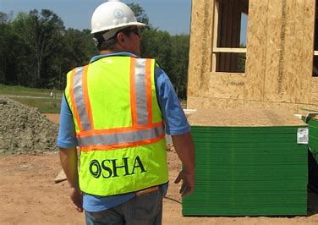
Best Practices for Heat Illness Inspections
Preventive measures
Reports of hospitalizations/fatalities
Advise clients of rights when OSHA knocks
  Manager/supervisor admissions
  Employee interviews
  Root cause investigations
Potential defenses
  Employee misconduct
  Lack of knowledge
  Reliance
Notes:
Courtney

Slide 22
Courtney M. Malveaux, Esq.
(804) 212-2862
Courtney.Malveaux@jacksonlewis.com

