Slide 1

CANNABIS
&
WORKPLACE SAFETY
Adele L. Abrams, Esq., asp, CMSP
Law Office of Adele L. Abrams PC
www.safety-law.com
301-595-3520 OFFICE
301-613-7498 MOBILE

Slide 2
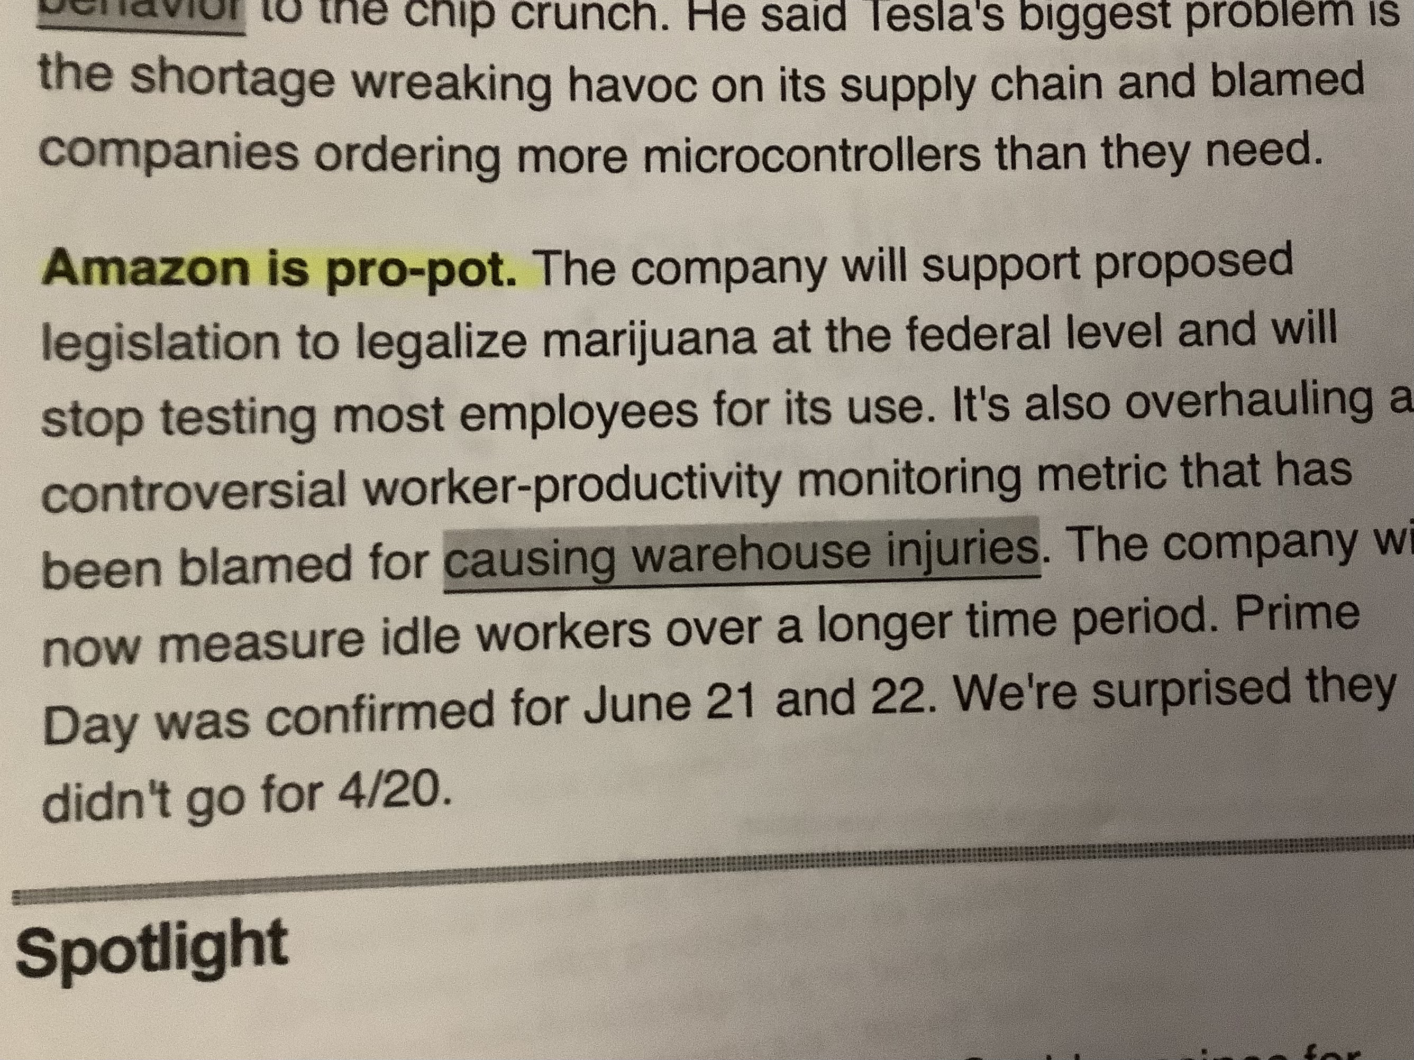
The times, they are a-changin’ …

Slide 3
$1.8 Mil. Judgment Against Employer Who Failed to Accommodate Opioid Use
Federal Dist. Ct. (D-WA 2017) ordered employer to pay terminated worker $1.8 mil in economic ($10K in emotional distress damages) for failing to accommodate prescription opioids prescribed to treat migraines and terminating her for positive drug test
  EE was customer service rep for 20+ years, always suffered migraines, took Dilaudid prescribed by doctor= doc said she could return to a few hours after treatment
ER’s “fitness for duty” policy prohibited EE from working “under influence of drugs or alcohol”
  Policy allowed drug test if manager had reasonable suspicion of impairment with NO exception for prescription drugs
When EE cried at desk after a reprimand, ER called this “reasonable suspicion” and ordered drug test but allowed her to remain at work despite “impairment”
  Doctor furnished note explaining treatment and ability to work without restrictions
  Drug test was positive and flagged as “safety sensitive warning for potentially sedating medication” – but worker was NOT in safety-sensitive position
Court found ER failed to accommodate EE under ADA, or to consider FMLA intermittent leave
Court said “Employer should have treated her as an employee with a medical condition, rather than as a drug abuser”!

Slide 4
Intersection of safety & HR Laws
FMLA, ADA & Worker’s Comp (WC): “The Treacherous Triangle” when it comes to medical cannabis use by employees - OSHA/MSHA further complicate matters
“Reasonable accommodation” of workers under ADA and state laws (use of medical marijuana) and workplace safety conflict – evolving area of case law
  Pending legalization at federal level can jettison existing ADA case law precedent!
Employers have legal obligation to protect workers from direct threats to safety under OSH Act – new penalties can reach $145,027 per affected worker
  OSHA can also take enforcement action arising from impairment on the job OR related to workplace violence incidents if foreseeable under GDC (Sec. 5(a)(1)!
MSHA prohibits possession of, or being under influence of alcohol or narcotics at metal/nonmetal mines including contractors
  Potential $75K for supervisors with knowledge & $291K fine against employers (includes contractors)
Both agencies’ anti-retaliation laws (MSHA – Sec 105C; OSHA Sec 11C & 29 CFR 1904.36) protect workers from being drug tested as a deterrent to reporting injuries or in retaliation for filing OHS complaints

Slide 5
OSHA, Drug Testing & Discipline
OSHA electronic recordkeeping rule took effect 12/1/16 and includes a ban on discrimination and discipline against injured employees that is not imposed on uninjured workers – rule is being reopened by Biden Admin to expand e-recordkeeping submissions (all public facing now)
  This allows penalties of up to $145,027 to be imposed for Sec. 11(c) violations (whistleblower rights) – expands SOL to 180 days by citing under 1904.36
29 CFR 1904.35 and 1904.36 require employers to inform employees of right to report work-related I/I free from retaliation
OSHA said that blanket post-incident drug testing policies can deter employees from reporting but then modified position in new policy

Slide 6
OSHA Policy on Drug Tests
Trump OSHA issued “clarifying” policy on 10/11/2018: https://www.osha.gov/laws-regs/standardinterpretations/2018-10-11
  Biden administration affirmed the 2018 policy in its 2022 whistleblower handbook rev:
  Random drug testing.
  Drug testing unrelated to the reporting of a work-related injury or illness.
  Drug testing under a state workers’ compensation law.
  Drug testing under other federal law, such as DOT regs for CDL
  Drug testing to evaluate the root cause of a workplace incident that harmed or could have harmed employees
  If the employer chooses to use drug testing to investigate the incident, the employer should test all employees whose conduct could have contributed to the incident, not just employees who reported injuries, and DOCUMENT!

Slide 7
Medical Cannabis Update
37 states (plus DC and all US territories) have legalized medical cannabis – latest are Alabama & Miss
19 states (plus DC, Guam and CNMI) have now legalized recreational MJ – and 13 more (plus USVI) have decriminalized its use
Federal cannabis decriminalization likely – Biden recently called for declassification as CDS & pardoned federal prisoners convicted of cannabis possession
  MORE Act would end criminalization of cannabis, remove from controlled substances list, eliminate related past criminal penalties and convictions.
    It also taxes cannabis products to fund social reform projects, make SBA loans to cannabis-related businesses, and prohibit denial of federal benefits & protections under immigration law based on cannabis-related convictions.
  SAFE Banking Act passed by House 4/19/2021 to allow commercial banking and credit card activity by licensed cannabis companies (321-101 vote!)
  Veterans Medical Marijuana Safe Harbor Act (S. 1183 / HR 2588), is bipartisan legislation to expand and facilitate medical cannabis access to military veterans suffering from chronic pain, PTSD, and other serious medical conditions.
  Legalization will negate current ADA case law that does not protect medical users because it is “illegal” federally

Slide 8
Election 2022: More Cannabis Legalization?
Maryland lawmakers approved legislation that places a Constitutional Amendment on the ballot for November. “Question 4” asks voters: “Do you favor the legalization of the use of cannabis by an individual who is at least 21 years of age on or after July 1, 2023, in the State of Maryland?” Possession of more than 2.5 ounces of marijuana would still subject the holder to criminal penalties.
Missouri voters will consider a citizens’ initiative that would allow those 21 years and older to possess, purchase, consume and cultivate cannabis, and would also automatically expunge non-violent criminal records for past cannabis offenses.
Nebraska’s medical marijuana initiative failed to gather the requite number of signatures to appear on the November ballot, but the issue is likely to continue before the legislature as 77 percent of residents polled supported legalizing medical cannabis access and the petition had 77,000 signatures.
North Dakota voters will consider a ballot initiative that would legalize adult (21+) use and sale of cannabis, as well as permitting cultivation of up to three plants in a home for personal use.
South Dakota will give voters the opportunity to decide on legal marijuana use by those age 21 and older; the measure allows possession of up to one ounce or three mature plants, but does not establish a regulatory framework or retail sales of marijuana in the state.

Slide 9
CANNABIS IN VIRGINIA & Employment
Bill removes criminal penalties for individuals but there is no employment protection for recreational cannabis users
Medical cannabis users are protected from being discharged, disciplined or discriminated against for lawful use of cannabis based on valid written certification – as of 7/1/2021
  If worker has medical cannabis card and drug test comes back positive, employer may not terminate or discipline SOLELY on basis of positive test!
Does not force employers to change current drug testing policies or any specific rules on use by employees – right to establish such rules is part of the written or implied employment contract
Provides safe harbor for employers to drug test workers in certain regulated jobs regardless of signs of impairment or certification to use medical cannabis
Does not require an employer to commit any act that would cause employers to violate federal law or result in the loss of a federal contract or federal funding
Does not require any defense industrial base sector employer to hire or retain anyone who tests positive for THC in excess of 50 ng
New law provides a complete bar to recovery for workplace injury when it results from intoxication (includes use of drugs or alcohol) if the intoxication causes or contributes to the injury

Slide 10
KEY Legal Decisions – Medical Cannabis
Noffsinger v. SSC Niantic Operating Co., LLC, d/b/a Bride Brook Nursing & Rehab. Ctr., (D. Conn. 9/5/18).
  Federal court held: refusing to hire a MMJ user because she tested positive on a pre-employment drug test violates Connecticut’s medical marijuana law, and granted SJ to applicant
  Court declined to award attorneys’ fees or punitive damages, and dismissed her claim for NIED
  Court rejected “federal pre-emption” argument and held Federal Controlled Substances Act doesn't regulate employment, so not illegal to employ a marijuana user
Coats v. DISH Network, Colo. Ct. of Appeals (2015).
  Reinforced right to terminate “positive” employee who held MMJ card, even in absence of evidence of impairment on the job.
    Basis was the fact that MMJ is still technically “Illegal” under federal law … if congressional bill passes, this decision could be invalid.
Casias v. Wal-Mart Stores, Inc. (6th Circuit, 2012)
  Court held Casias had no claim of wrongful discharge as Michigan’s Medical Marijuana law did not regulate private industry. The law only provides protection from criminal prosecution
  BUT … Walmart just lost major case in AZ because state MMJ did have employment protections!

Slide 11
ACLU MMJ Case
ACLU v. Darlington Fabrics, held applicant was discriminated against for refusal to hire due to admission of MMJ use for migraines
Candidate had disclosed use and promised not to come to work under influence but was told she would not be hired because of current use of MMJ.
She was NOT alleging discrimination under federal ADA, but under RI MMJ Act, which prohibits employment discrimination based on individual’s status as MMJ cardholder.
  Employer lost on Summary Judgment and case is still active
States with similar protections: AZ, CT, DE, IL, ME, MN, NV and NY
  Arizona and Delaware laws are similar to RI and seek to prevent discrimination in “hiring, termination, or any term or condition of employment, or otherwise penaliz[ing] a person…status as a cardholder” or due to positive drug test for marijuana.

Slide 12
Medical Cannabis & Worker’s Comp
The following states hold that employers must reimburse workers who are legal medical cannabis patients :
  Arizona
  Connecticut
  Hawaii
  Maine
  Minnesota
  New Hampshire
  New Jersey
  New Mexico
  New York
  Rhode Island
  Vermont
State laws in flux:
  Delaware
  Maryland
  Pennsylvania
The following states hold that employers do NOT have to reimburse workers:
  Florida
  Massachusetts
  Michigan
  North Dakota

Slide 13
NJ & worker’s Comp Cannabis Payment
NJ Superior Court, Appellate Division, recently held that an employer is required to reimburse its employee for the worker’s use of medical marijuana prescribed for chronic pain following a work-related accident.
Hager v. M&K Construction is the latest in a series affirming this position in New Jersey, in both the private and public sector
Court found there was not a tension between the NJ Medical Marijuana Act and the Controlled Substances Act, because the employer was not being required to possess, manufacture or distribute the drug but only to reimburse its employee for the purchase of medical marijuana; therefore, the employer faced no threat of prosecution as it had alleged.
Injured worker had chronic back pain from work injuries and resulting surgeries, and after 15 years of opiate use, became a medical marijuana patient – court agreed this was beneficial compared with opiate use
Similar decisions now in Maine and NH – impact earlier decisions in PA

Slide 14
Developing Prevention Programs
There are five basic components of substance abuse prevention programs:
A written policy
Supervisor training
Employee education
Employee assistance
Drug and alcohol testing

Slide 15
Drug Free Workplace Policy
Should include:
  Rationale
  Prohibited behaviors - – is focus “impairment” or “positive test”?
  Substances covered
  Employees affected
  Consequences of policy violation
  Enforcement means
  Availability of assistance
  Very important that programs at union operations be developed in conjunction with union agreement to avoid CBA violations or claims of Sec. 8(a)(1) violations (changes in terms and conditions of employments unilaterally by employer)

Slide 16
Reasonable Suspicion Testing
Allowed in all states BUT there may be specific provisions (particularly in state medical cannabis laws) that govern – also watch for municipal laws that may limit testing, especially in non-safety-sensitive positions
Reasonable suspicion testing is also covered extensively in DOT rules and regulations, which require that determinations to conduct reasonable suspicion testing be based on specific contemporaneous articulable observations of employee conduct, behavior, appearance or body odors
Private employers with non-DOT employees are also free to perform reasonable suspicion testing, subject to applicable state laws.
Observations made of the employee exhibiting signs of impairment must be articulable and documented by a supervisor who has participated in training on the signs and symptoms of alcohol misuse and drug abuse and the requirements for reasonable suspicion testing
  NOTE: In the case of reasonable suspicion alcohol testing, the observations of employee behavior, conduct, or appearance must be made just before, during, or just after performing safety-sensitive duties.
  Unlike reasonable suspicion alcohol testing, a reasonable suspicion drug test determination may be made at any time the supervisor observes employee behavior or appearance indicating possible use of controlled substances.

Slide 17
WHAT IS IMPAIRMENT???
Many employers use 20 ng for MJ (SAMHSA recommends 50 ng) but low test cutoffs can capture CBD-only products (which can contain up to .3% THC legally)
Colorado, Washington and other states where now legal will need to address through DUI laws … 5 ng level per se in WA; “permissible inference” in CO at 5 ng
DOT has zero tolerance for CDL drivers, pilots and train engineers
Growing field of forensics to determine if workplace accident victims were impaired – consequences for worker’s compensation, OSHA/MSHA liability, affirmative defenses in wrongful death and personal injury cases of contractors injured OTJ

Slide 18
Illinois “Compassionate Care” law & Impairment
Illinois cannabis law says: Employer may consider patient to be impaired when he or she manifests specific, articulable symptoms while working that decrease or lessen his or her performance of the duties or tasks of the employee’s job position, including:
  symptoms of the employee’s speech, physical dexterity, agility, coordination, demeanor, irrational or unusual behavior, negligence or carelessness in operating equipment or machinery, disregard for the safety of the employee or others, or involvement in an accident that results in serious damage to equipment or property, or careless that results in any injury to the employee or others.”
If employer elects to discipline a patient, it must afford the employee a reasonable opportunity to contest the basis of the determination.

Slide 19
CBD Issues
Legally sold in all 50 states and on the internet
No FDA approval nor testing of products (outside of legal dispensaries)
Researchers at University of Miami assessed 516 CBD products, 121 of which were intended for oral consumption, and found:
  42 percent of products tested positive for the presence of lead,
  37 percent were positive for mercury,
  28 percent were positive for arsenic, and
  8 percent were positive for cadmium
  Heavy metal contamination was also identified in unregulated delta-8 THC vape pens
CBD does NOT cause impairment … but it CAN contain up to .3% THC legally … and use can trigger positive cannabis drug test
  WV Supreme Ct. (4/22) held coal miner using OTC CBD product and testing positive for THC could have surface coal miner certification suspended by state because law doesn’t make distinction in positive test cases after using legal forms of cannabidiol (miner had won in initial Mine Safety Board hearing but state appealed – dissent criticized punishing worker for “engaging in perfectly legal activity.”

Slide 20
Opiates & ADA
Taking prescription opioid medication under doctor’s orders may be protected by the ADA
Under the ADA, an employer cannot discriminate on the basis of disability but if, over time, the disability no longer exists, or if the medication is interfering with the worker’s ability to perform essential job functions with reasonable accommodations, or if he/she is taking the medication illegally, then they can be fired
2nd Circuit Court of Appeals has held that when an employee returns to work “special conditions imposed on employees identified as substance abusers do not violate the ADA”, even when they are more onerous than conditions imposed on other employees

Slide 21
ADA Direct Threat to Safety: Factors
Bragdon v. Abbott (S. Ct. 1998) – A “good faith belief” that a risk is significant is not enough to meet the standard. The determination of “significant risk” must be based on medical or other objective or scientific belief.
In determining whether an individual would pose a direct threat, the factors to be considered include:
  The duration of the risk
  The nature and severity of the potential harm
  The likelihood that the potential harm will occur
  The imminence of the potential harm

Slide 22
ADA Solutions: Document Accommodation Efforts
Make sure to engage in interactive process with employee concerning reasonable accommodations that may be options to address EE’s disability needs in order to perform essential job functions
Make sure to have WRITTEN job descriptions that delineate what each position’s “essential job functions” actually are and which positions are classified as “safety sensitive”
If the disability posing threat to safety cannot be mitigated:
  Document the accommodations ER has considered
  Explain why they did not sufficiently minimize the risk of direct threat to safety
  Make sure your determination is based on objective criteria, nonbiased decision maker, and (where applicable) sound medical judgment.

Slide 23
Supervisor Training: Best Line of Defense
Supervisors’ role: recognition (reasonable suspicion training), documentation, confrontation, referral, follow-up (not diagnosis or counseling)
Supervisors need to be informed on how to identify an addiction-related problem in advance of a catastrophic event, as well as how to get help for addicted workers.
Workers who are suspected of being “under the influence” should be taken to a private area, and a second supervisor or witness should be present to document any action or statements.
Senior management must be notified of these events.
It may be necessary to suspend a worker until an investigation can take place and/or until the worker completes treatment or is evaluated by the company EAP.

Slide 24
Things to Do Now
Check your current drug testing program against new OSHA e-Recordkeeping rule and applicable state law(s) for your company and watch for changes in 2023 (state & fed)
Consider shift to “Fit for Duty” style testing such as Druid or Sobereye, rather than testing specific substances (covers fatigue, stress, shift work factors) EXCEPT DOT and critical safety sensitive positions – and check your job descriptions to flag SSP
Make sure you are conforming with requirements that might apply under rules for government contractors, DOT and requirements under the ADA
Make sure that in a union environment, any policy is negotiated as part of the CBA as drug testing can be a “term and condition of employment” under the NLRA
Make sure supervisors are trained on identifying impairment
Make sure all employees are treated fairly and do not treat injured workers in a disparate manner

Slide 25
Questions?
Adele L. Abrams, Esq., CMSP
301-613-7498 mobile
301-595-3520 DC area office
www.safety-law.com
safetylawyer@gmail.com

