Slide 1
What to Expect when You’re Inspected
And a Case study – seaworld of florida, llc v. perez

Slide 2
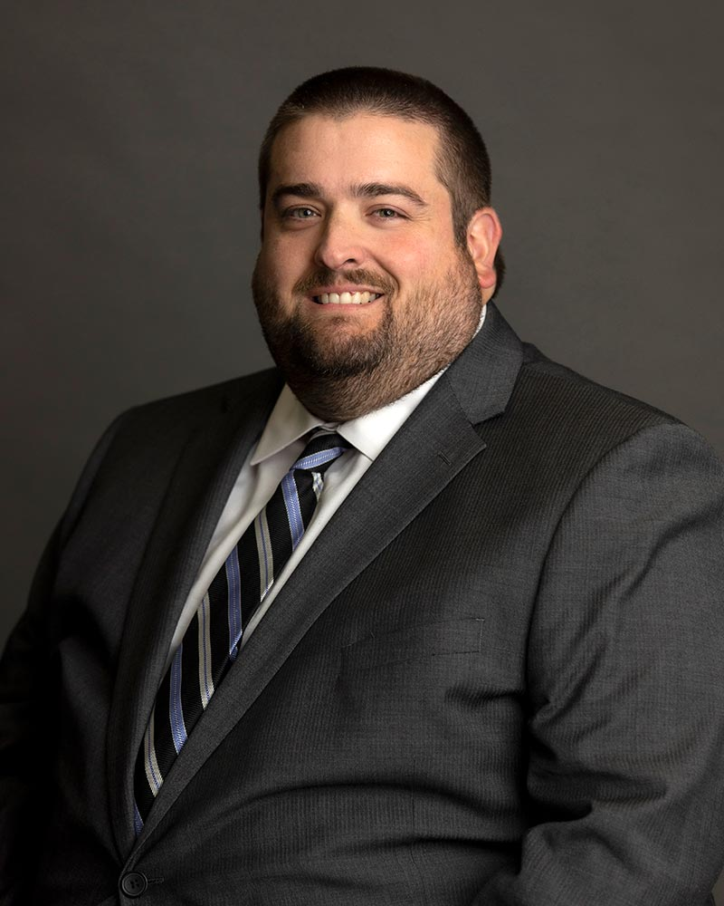
Who am I?
Of Counsel at David, Kamp & Frank, L.L.C. in Newport News
Representing businesses VOSH and OSHA inspections, both pre- and post-citations
Trial attorney
Former Litigation Manager for Virginia Department of Labor and Industry
Division of Legal Support
Worked closely with VOSH Division enforcement
Pre-citation review of significant casefiles
Post-contest review of contested casefiles
Bringing contested citations into court, and to either a trial or settlement
Appeals
Former Safety Specialist, Busch Gardens Williamsburg / Water Country USA
Case study later time-permitting – SeaWorld of Florida, LLC v. Perez, Secretary of Labor

Slide 3
Lifecycle of an Inspection - fatality
Day of incident at your facility (Day 1); you report it timely (within 8 hours – day 1)
Day 1
OSHA forwards the report to VOSH, VOSH inspector reaches out (Day 1)
Opening conference (probably abbreviated if a fatality)
Walkthrough
Interviews of management and possibly line-level staff
Initial closing conference
Day 2-120
Emails from CSHO, requesting documents, contact info of interviewees, second walkthrough
Day 160-180
Final closing conference (Email? Phone call? Nothing?)

Slide 4
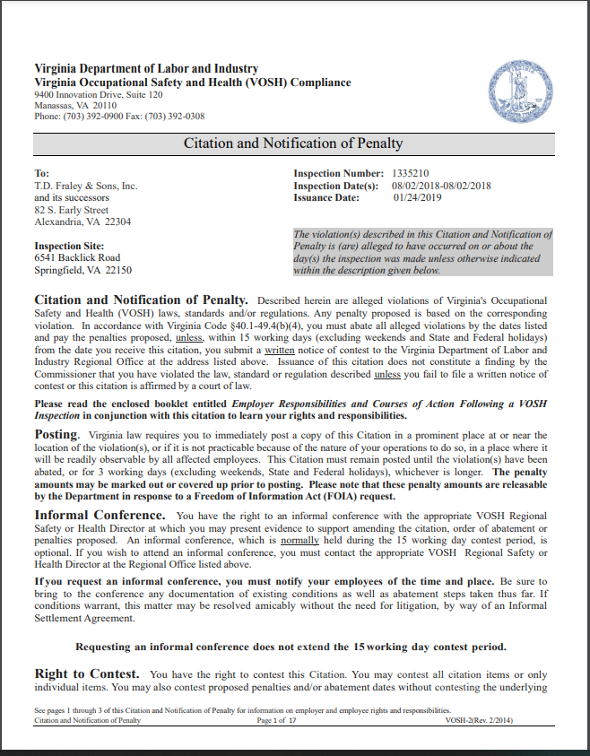
Lifecycle of an Inspection - fatality
Day 180 – Citation package issued
CSHO recommends citations
RD reviews and issues
Significant cases? PD and DLS review too
Sample shown later

Slide 5
Lifecycle of an Inspection - fatality
Day 182 – you actually receive the citation package by USPS certified mail OR commercial delivery service
Post “in conspicuous place and in unobstructed view at or near place of alleged violation” for three working days or until abated (16VAC25-60-40 & 1903.16)
Starts 15 working day deadline to give a written notice of contest!
Day 185 – you request an informal conference with the Regional Director
Posting obligation for a page of the packet
Does not change the notice of contest deadline!

Slide 6
Lifecycle of an Inspection - fatality
Day 197 – Informal Conference AND NOC deadline
Not going to get this resolved so… you provide a WRITTEN notice of contest (NOC)
Days 198 – 500: Settlement limbo with region (~1 year after contest)
Days 500 – 927: Settlement limbo with headquarters (Program Directors and/or Legal)
Days 400 – 1,000: Civil Complaint is filed in a circuit court by the Commonwealth’s Attorney against your business*
*If you are a public employer (governmental) – you get an administrative hearing before an “agency subordinate”

Slide 7
Long haul
Incident
Citation
Contest Litigation STARTS
1
180
900

Slide 8
Litigation Process
DOLI attorney gets appointed by the court, at request of Commonwealth’s Attorney, Special Assistant Commonwealth’s Attorney
Complaint filed – Gary G. Pan, Commissioner v. [Your Business, Inc.]
Where? City/county circuit court where the violation occurred
When? No explicit statute of limitations, but case law suggests within 2 years of NOC. Cases have been won and lost between 12 and 36 months, however
When do employers win on this? When they have been prejudiced by the delay
Service of the Complaint and summons
Registered Agent with the SCC, or an officer/director of your corporation, or manager of an LLC

Slide 9
More deadlines / traps!
Service of the Complaint starts a 21 day deadline to file a responsive pleading
Who? A licensed attorney must file pleadings for a corporation or LLC
What? Answer or a motion to dismiss (“Demurrer” or a “Plea in Bar”)
Consequences? You’re in default, and you don’t get to have a trial or put on evidence… you lose
Can you get an extension? Usually but only by motion, which is a pleading --- and must be filed by an attorney

Slide 10
Discovery
Interrogatories (questions to be answered)
Requests for Production (documents that must be provided)
Requests for Admission (admit or deny that…)
Neglect to answer? After 21 days, DEEMED admitted
Depositions of witnesses and parties
Sworn, in person or Zoom, testimony before a court reporter
CSHO (always)
Your supervisors on site, or you (i.e., EHS) (almost always)
Your line-level employees (sometimes)
Regional Directors (sometimes)
Experts (rarely)

Slide 11
Trial
Before a judge – no jury
Usually 12-24 months after the Complaint is filed
Remember--- could be as much as Day 1,657 (197 + 4 years)
Burden of proof is on VOSH
“Preponderance of the evidence” – more likely than not
Four elements of proof
Cited standard applied
Cited standard was violated
Employee exposure (or access to hazard)
Employer knowledge of violative condition
Appeals – Court of Appeals of Virginia, then Supreme Court of Virginia (discretionary)

Slide 12
Actual timeline – Inspection # 1235116
May 22, 2017 – hospitalization occurs; is reported; inspection begins (Day 1)
July 31, 2017 – citations issued (Day 7); timely NOC 8/10/17 ($4,845 in penalties)
July 26, 2019 – Complaint filed in Washington County Circuit Court, Abingdon (Day 795)
November 19, 2020 – One day bench trial (Day 1,277)
February 23, 2021 – Judge issues decision (Day 1,373)
March 25, 2021 – Appealed by DOLI to the Court of Appeals of Virginia (Day 1,403)
January 18, 2022 – Opinion of the Court of Appeals issued (reversed and remanded) (Day 1,702)
February 15, 2022 – Employer noted appeal to the Supreme Court of Virginia (Day 1,730)
September 15, 2022 – Supreme Court refuses to take the appeal (Day 1,942)
February 1, 2023 – Case settled - Agreed Order entered (Day 2,081)

Slide 13
Typical?
Absolutely not! One and only appeal in 10 years
Vast majority settle at all points in the timeline
Pre-citation settlement (extremely rare – 1 every decade)
Pre-informal conference settlement (rare)
Informal conference settlement (very common)
Post-IC/post-contest (common!)
HQ review (common)
After Complaint is filed (common)
The week of trial (common)

Slide 14
What do you do with all of that?
(Hire a lawyer)
(Earlier the better)

Slide 15
Lawyer on Day 1
MYTH:
Hiring a lawyer puts you on the “naughty list”
Hiring a lawyer means you’re “guilty”
VOSH will always be reasonable and deferential to business
There’s nothing I can do when a CSHO shows up – they get carte blanche to look at anything
TRUTH:
Many employers hire a lawyer, and VOSH expects it with some. It helps the inspection process, especially where the lawyer knows the area
VOSH does not view it that way
Unfortunately, not always. Depends on the CSHO, RD, policy pressures, OSHA FAME emphasis, etc.
No!

Slide 16
Scope of the Inspection
The scope of an inspection is limited to the reason they came to your worksite (and the scope of your consent), and what they encounter once on your site
VOSH’s only right to be on your worksite is either (1) consent or (2) an inspection warrant
Consent can be limited in scope, and withdrawn at any point
Fourth Amendment search and seizure rights apply to inspected businesses
Not every inspection is wall-to-wall
Scheduled inspection – wall-to-wall only if the written directive about that schedule/program says so
Complaint/fatality/accident/referral-based inspections – partial scope limited to scope of report
You have a right to see the complaint (but not the identifying information of complainant)

Slide 17
Will VOSH wait?
Myth: I can’t call a lawyer or my regional safety manager, because that would delay the inspection and they won’t allow that.
Fact: VOSH’s Field Operations Manual (FOM) says they will wait up to 1-2 hours for someone to show up (more senior manager, safety professional, or even an attorney) before considering it a denial of entry
In practice, some regions and CSHOs will allow an inspection to be postponed until the next day (no specific time)

Slide 18
Opening Conference
CRITICAL!
Direct CSHO to a conference room out of sight of work
Establishes why VOSH is there
Establishes the scope of the inspection
If complaint, ask for a copy of the complaint (frame it: not looking for the complainant)
You want the content – what work area? What hazards?
Involve a trained supervisor ASAP. Call your EHS professional, and ideally, the attorney
Train initial responder to not make any broad statements about accidents, safety, etc. until the scope is established
BUT: never discourage employees from speaking with VOSH (even if you know their complaints are bogus, they are protected by law from retaliation)
Supervisors can be trained on how to speak with VOSH
Even if you know who the complainant is, don’t tell VOSH without asking your attorney re: strategy

Slide 19
You’re only as good as your worst supervisor
Element 4 : Knowledge usually established by statements of your supervisors (in interviews and during walkthroughs, conferences, or even to police – all have the same effect)
A Serious becomes a Willful-Serious because of statements of your supervisors (10x penalties, SVEP, etc.)
NO employee misconduct if the employee is a supervisor (anyone who manages folks)
Not just hire-fire authority, anyone who delegates work or monitors progress, etc.
Narrow exception if rogue supervisor is only exposed employee
Statements of a supervisor bind the company
So attorneys are allowed/encouraged to be present at their interviews
Strategy decision: Don’t agree to day-of incident/walkthrough interviews with supervisors
You do not have to do this / need preparation / need an attorney present (this is allowed)

Slide 20
Opening Conference -> Walkthrough
You’re allowed to postpone unnecessary work in the area to be inspected (at your discretion)
Guide the CSHO from the opening to the area of concern
Plain view apparent violations = expanded scope
Plain view forklifts ≠ now a forklift inspection

Slide 21
Walkthrough
Take the same photos / videos as the CSHO
CSHO is allowed to video/photograph
If there are trade secrets in the area, establish that (ideally at the opening conference) and all videos/photos will be protected from FOIA
CSHO wants to see someone operate a machine
VOSH/OSHA is not entitled to observe actual work
May want to show them – but only use someone you trust who actually uses the machine regularly (and safely!)
If the machine might be lacking a guard, just respectfully decline (without a why)

Slide 22
What if it goes sideways with the CSHO?
Strategies are not plug and play. Strategies should be determined for each inspection/company/facility
Most aggressive strategy that is fully within your rights?
We do not consent to your inspection at this time, please return with a warrant
Can VOSH “punish” you later by racking up penalties?
NO – cannot be punished for invoking your Fourth Amendment rights. If they do, a judge will not take kindly
Will they get a warrant? Yes, but probably will take a few days
Less obvious denials of entry exist (and CSHOs are taught to ask Legal if they think conduct amounts to a denial, i.e., refusing to consent to interviews, refusing to allow photos)

Slide 23
Days 2 - 179
Document requests:
VOSH cannot issue a subpoena for documents under current law
They can submit to you written interrogatories, which must be answered under oath within 30 days
VERY RARE, usually can be avoided with a document production (but note they have no way until litigation of compelling you to produce every document responsive)
Documents by regulation that must be given:
OSHA 300, 301, 300A logs/reports (within 4 business hours of the request)
Respiratory program documents as specified in 1910.134(m)
Other specific standards (HAZCOM, noise) with specific language that docs must be given upon demand
Remedy? Almost always a zero dollar penalty OTS citation, or they presume you don’t have one
Takeaway? Be strategic about responding to document requests
Have them all go through one person (ideally, the attorney)
For larger volumes - treat responses like a discovery response (with objections reserved, etc.)

Slide 24
Days 2 - 179
Documents frequently requested that are NOT required to be given (necessarily):
Most written programs (i.e., forklift/PIT, first aid trainings/certs, BBP docs other than Exposure Control Plan)
BUT – they will assume you do not have one and cite you for it
So sometimes better to provide it, maintaining your objections to its relevance
Smoking gun document that sinks your case? Consult an attorney on whether it has to be given
Probably does not
Takeaway? Be strategic about responding to document requests
Have them all go through one person (ideally, the attorney)
For larger volumes - treat responses like a discovery response (with objections reserved, etc.)

Slide 25
VOSH’s right to interview in private
While you should ask the CSHO to only reach out through your point of contact (attorney), little stops the CSHO from going directly to your employees, particularly non-supervisory
VOSH has a statutory right to interview ANY agent or employee “in private”
Interpreted by VOSH to mean non-supervisory employees (without notice to you)
In NC: anyone, including supervisors
VOSH invokes this right to deny all requests/demands to identify not only (1) who they spoke with, but also (2) the content
Consequently, they usually cannot use those statements in evidence at trial without giving them up

Slide 26
Notes:
You get cited!

Slide 28
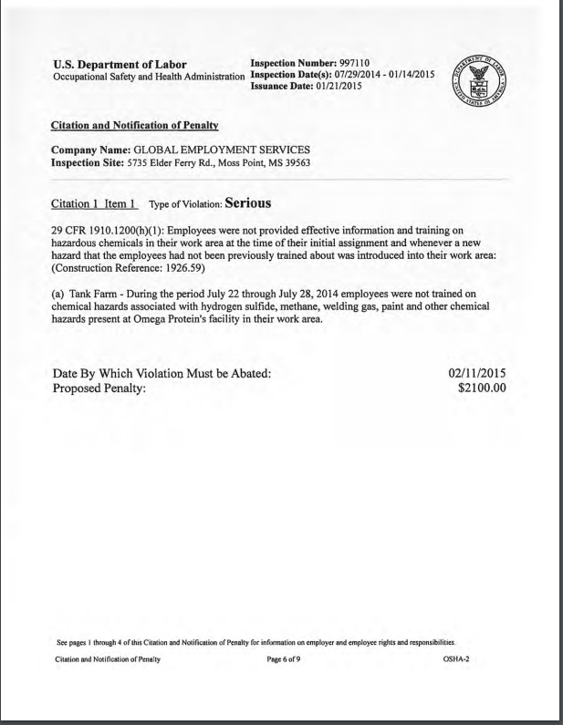

Slide 29
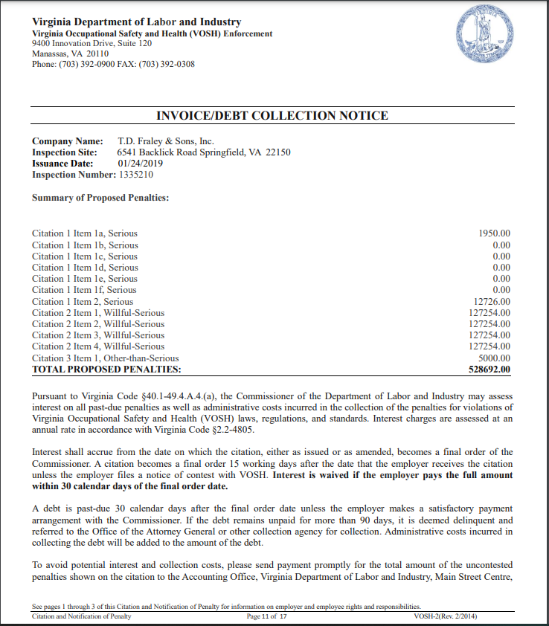

Slide 30
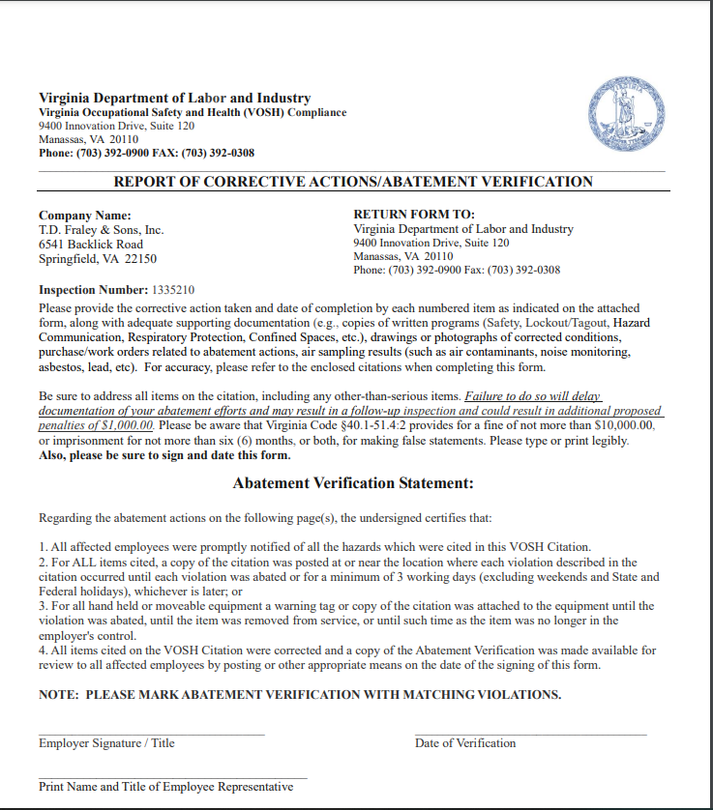

Slide 31
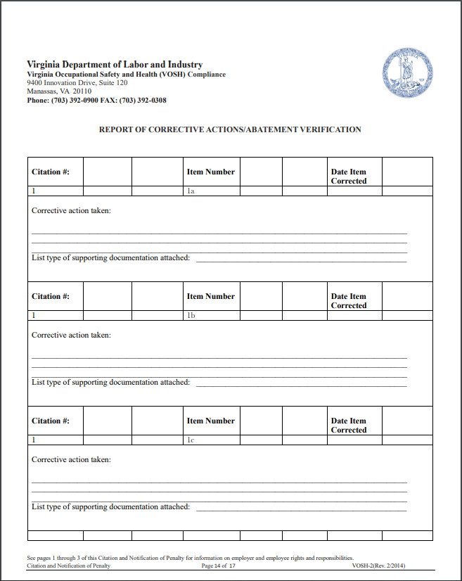

Slide 32
15 Working Days to Contest
The most important deadline in the whole process!
Do not count weekends or state holidays (state website, or Va. Code § 2.2-3300)
WRITTEN
Not a voicemail
Emails, letters, faxes = a writing
Consequence of missing this?
“Final Order not subject to review by any court or agency”
No excusable neglect, like with federal OSHA contests

Slide 33
Informal Conference
Almost always a good idea to request one
Increasingly being done virtually (since COVID)
Think about who goes.
Line level supervisor may not need to be there, particularly if they were involved in a citation item
Anyone the casefile will reflect poorly upon should probably not be there
Usually with the Regional Director only, not the CSHO
Even more rarely – DLS will attend (if this happens, your case is a major agency priority)
May be offered an EISA – Expedited Informal Settlement Agreement
Usually just a ~20% penalty reduction, no strings attached except abatement
That might tell you something about how strong VOSH thinks their own case is!
Alternative: ISA – Informal Settlement Agreement
More reductions/penalty decreases, payment installments, enhanced abatement sometimes

Slide 34
Willfuls, Repeats, and Fatalities
RDs alone cannot settle the following, other than penalty reduction up to 30-50%:
Fatality-related violations of any kind
Willful violations
Fatality-related Serious violations are unlikely to be reduced in settlement to OTS
Same usually with serious physical injuries resulting from a violation

Slide 35
Case Study – SeaWorld of Florida v. Perez

Slide 36
Facts
Feb. 24, 2010 – Dawn Brancheau, a highly skilled animal trainer of orca whales died on the job at SeaWorld in Orlando
She was doing a small private show, although she also did the larger stadium shows, in the water with the animals, swimming with them and doing stunts
Reclining on her back in a shallow part of the pool. Tillikum was supposed to mimic and roll over, but instead grabbed her by the hair and dragged her underwater, causing her to drown

Slide 37
Cited: Willful General Duty Clause

Slide 38
What is the General Duty Clause?
OSH Act created two broad obligations on employers: 29 USC 654(a)
(1) “furnish to each of his employees employment and a place of employment which are free from recognized hazards that are causing or are likely to cause death or serious physical harm to his employees.”
(2) follow specific standards that get issued by OSHA

Slide 39
What is the General Duty Clause?
OSH Act created two broad obligations on employers: 29 USC 654(a)
(1) “furnish to each of his employees employment and a place of employment which are free from recognized hazards that are causing or are likely to cause death or serious physical harm to his employees.”
(2) follow specific standards that get issued by OSHA

Slide 40
What is the General Duty Clause?
Exposed employee must be the same as the one creating the hazard
Hazard must be causing or likely to cause death (or other serious injury) (no OTS general duties)
“Recognized”
By the employer itself
By the employer’s industry

Slide 41
Four Elements of a General Duty Violation
First – an activity or condition presented a hazard to that employer’s employee in workplace
Second –a recognized hazard existed (employer recognized, or industry recognized)
Contested
Third – that hazard was likely to or did cause death or serious physical harm
Fourth – one feasible means of abatement (eliminate or materially reduce the hazard) existed
Contested

Slide 42
Recognized hazard
Evidence used against SeaWorld
Previous accident investigation reports of trainer injuries with animals
Emails with senior management about the dangers of working with killer whales
Also showing prior knowledge of Tilikum's previous incidents (killed two other people – one trespasser, and an employee at a company in Canada)
SeaWorld argued that killer whale behavior is unpredictable and thus they could never have recognized the hazard of a sudden incident like this
Why is performance “waterwork” a problem, but not husbandry “waterwork”?
Judge found measures in place to limit mobility during husbandry

Slide 43
Feasible means of abatement
VOSH/OSHA just has to prove ONE
Economic and technological feasibility
Recent case says – burden is on OSHA to prove both in their prima facie case
OSHA must show the judge why doing the suggested method is feasible vs. you have to explain why it is infeasible
HUGE POINT:
Feasibility can be shown by employer implementing the action before the trial
Normally, subsequent remedial measures are inadmissible as evidence
BUT, exception exists for when the taker of the action suggests such an action is infeasible
Whales can perform same performance stunts without any human in the water

Slide 44
But… not a Willful violation
Willful means a knowing violation of the law, or “plain indifference to employee safety”
Trial judge found it did not rise to this level
SeaWorld thought it was protecting employee safety

Slide 45
Appeals
SeaWorld lost at the trial court level (except the willful was cut to serious)
Appealed to the D.C. Circuit Court of Appeals
Lost on appeal 2-1
Dissent filed argued this starts a slippery slope related to performer safety in professional sports like NASCAR, MLB, NFL, etc.
Challenges the basic tenet underlying the OSH Act that employees cannot assume any risk of their work by choice
To the extent the employer controls the risk, it must do so
Dissent written by then-judge Brett Kavanaugh

Slide 46
Result?
SeaWorld had to permanently change a major part of their identity
Built around the orca shows, the Shamu character, and interactions between humans and animals
No trainer/performer ever entered an orca habitat ever again after Dawn’s death (long before this came up in court)
Stock price plummeted (Blackfish documentary did not help)
Layoffs
As of February 2024, company name finally changed to “United Parks and Resorts”

Slide 47
Other lessons from amusement parks
Lock out tag out
Rides are just large industrial machines that people get strapped into
Many fatalities in industry from struck-bys
Best practices:
Establishing Ride Restricted Areas (fencing, elaborate locks, signage, training)
Establishing group lockout procedures (scissor clamps with individual locks for evacuations)
Or anyone who needs to enter the RRA
Engineering/PLCs – open gates = emergency stop
Restart procedures (audible warnings)

Slide 48
Questions?
Email: awwest@davidkampfrank.com
Cell: (757) 814-4762

